Slide 1
Chikungunya proteome data analysis

Slide 2
Methods
All skeletal muscle cell samples were used for the analysis.
Different log2(Heavy/Light) cutoffs and number of consensus samples are used to generated up/down regulated protein signatures, specifically,
Lysate1: proteins that have a log2 fold change > 0.1 in at least 3 out of 6 cell lysate samples, leading to 63 down, 115 up proteins with gene symbols.
Lysate2: proteins that have a log2 fold change > 0.2 in at least 2 out of 6 cell lysate samples, leading to 72 down, 150 up proteins with gene symbols.
Supnt: proteins that have a log2 fold change > 1 in at least 1 out of 6 cell supernatant samples, leading to 12 down, 13 up proteins with gene symbols.
Combined: proteins that have a log2 fold change > 1 in at least 1 out of 12 cell samples, leading to 46 down, 63 up proteins with gene symbols.
Enrichment analysis for gene lists were performed using Enrichr
Drugs with potential to reverse the virus infection signatures were identified using L1000CDS2

Slide 3
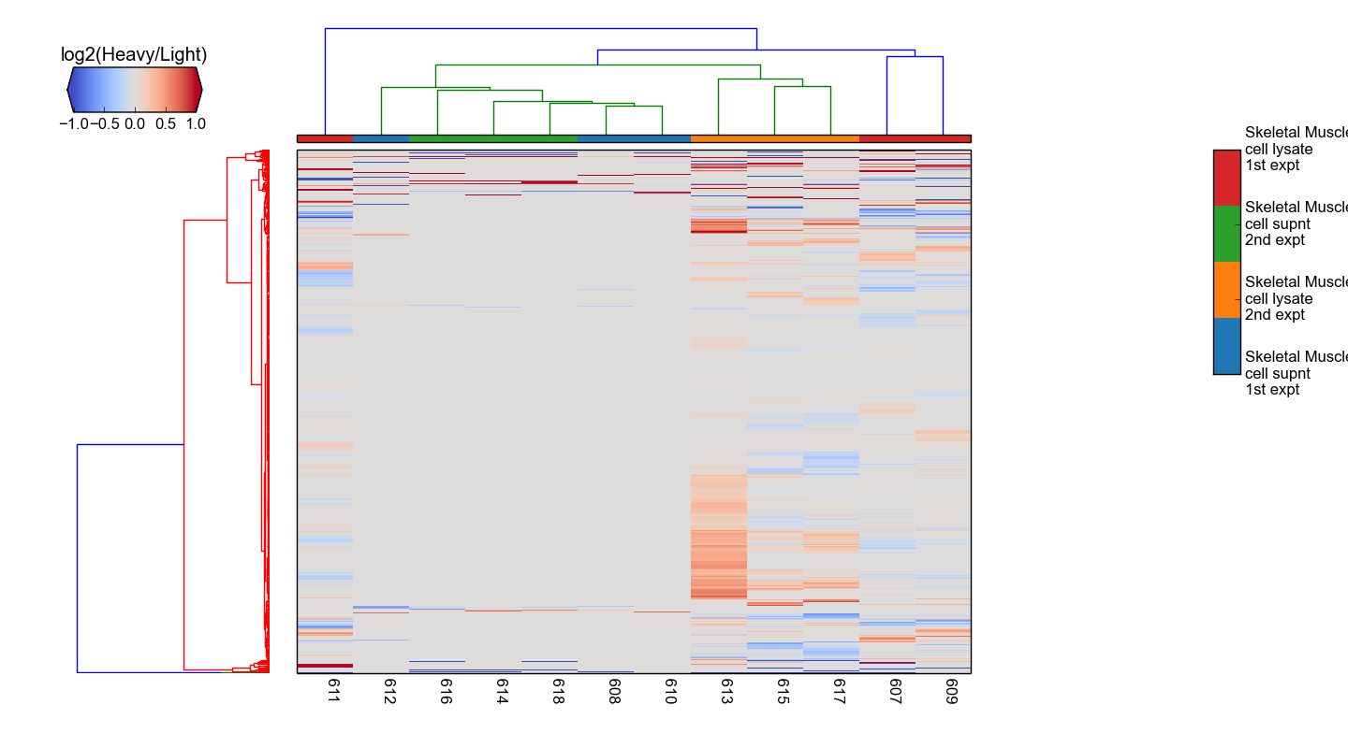
Hierarchical clustering of samples

Slide 4
Enrichment analysis
Gene list | Size | Link
lysate_genes_dn1 | 63 | cell communication, mRNA Processing, Regulation of mRNA stability by proteins that bind AU-rich elements, mRNA Splicing, Influenza Life Cycle GABARAPL2, GABARAPL1 MAP3K3, MAP3K14 extracellular vesicular exosome (GO:0070062)
lysate_genes_dn2 | 72 | cell communication, mRNA Processing, Regulation of mRNA stability by proteins that bind AU-rich elements, DNA Damage/Telomere Stress Induced Senescence, mRNA Splicing GABARAPL1, MAP1LC3A CDK5 extracellular vesicular exosome (GO:0070062)
lysate_genes_up1 | 115 | Ribosome, SRP-dependent cotranslational protein targeting to membrane, Viral mRNA Translation SLC2A4, GABARAPL1 MAP3K3, MAP3K14 extracellular vesicular exosome (GO:0070062),
lysate_genes_up2 | 150 | Ribosome, Extracellular matrix organization, SRP-dependent cotranslational protein targeting to membrane, SRP-dependent cotranslational protein targeting to membrane SLC2A4, GABARAPL1, GABARAPL2 MAP3K14 extracellular vesicular exosome (GO:0070062)
supnt_genes_dn | 12
supnt_genes_up | 13
combined_genes_dn | 46 | cell communication, Complement and Coagulation Cascades, Extracellular matrix organization, GABARAPL1, ALB extracellular vesicular exosome (GO:0070062)
combined_genes_up | 63 | ecm receptor interaction, Inflammatory Response Pathway SLC2A4, MAP1LC3B extracellular vesicular exosome (GO:0070062)
Hyperlinks are available to the full Enrichr results

Slide 5
L1000CDS2 links
Signatures | Top reversing drugs
Lysate2 | Homoharringtonine: protein translation inhibitor, treat CML BRD-K80348542: Cephaeline, alkaloid that is found in plants Emetine Dihydrochloride Hydrate (74): Apoptosis inducer BRD-K94325918: Kinetin riboside, anti-proliferative agent which induces apoptosis BRD-K60230970: MG-132, proteasome inhibitor CYCLOHEXIMIDE: inhibitor of protein biosynthesis in eukaryotic organisms TGX-115: PI3-kinase inhibitor Importazole: inhibitor of the transport receptor importin-β
Combined | Importazole JAK3 Inhibitor VI BRD-K76674262: Homoharringtonine Tyrphostin AG 957: inhibitor of human p210 protein tyrosine kinase Emetine Dihydrochloride Hydrate (74) BRD-K94325918: Kinetin Riboside
Hyperlinks are available to the full L1000CDS2 results

